Slide 1
Fall 2017
Instructor: Dingding Wang

Slide 2
Self-Introduction
11 years experience in data mining, information retrieval, and machine learning.
Academia:
Research Associate - Center for Computational Sciences at University of Miami
Assistant Professor – CEECS at FAU
Industry:
Data Scientist – DailyMe, Inc.
Summer Intern (07-09) – NEC Labs

Slide 3
Class Information
Wed/Fri 12:30am – 1:50pm CM125
Office hour: Wed/Fri 10:30am-11:30am EE 510
3-4 assignments (tool based)
1 presentation: Show how to use an IR tool or survey on an interesting topic
1 exam

Slide 4
Topics
Text preprocessing and representations
Scoring, term weighting, and the vector space model
Natural language processing
Relevance feedback and query expansion
IR system evaluation
Text classification and clustering
Text summarization
Web search
Recommendation systems
Other related topics

Slide 5
Information Retrieval
Information Retrieval (IR) is finding material (usually documents) of an unstructured nature (usually text) that satisfies an information need from within large collections (usually stored on computers).
These days we frequently think first of web search, but there are many other cases:
E-mail search
Searching your laptop
Corporate knowledge bases
Legal information retrieval

Slide 6
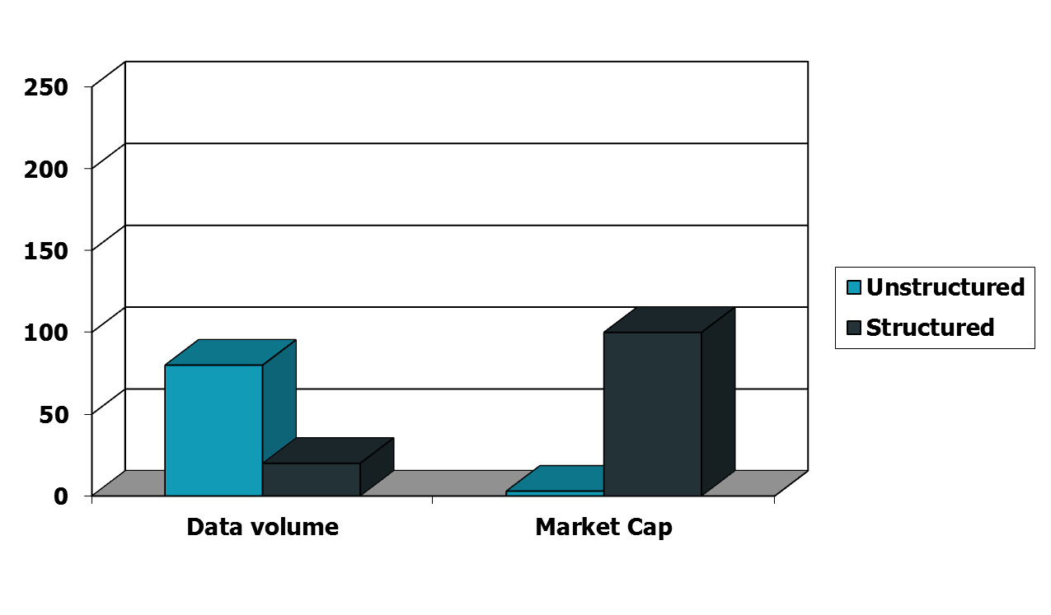
Unstructured (text) vs. structured (database) data in the mid-nineties

Slide 7
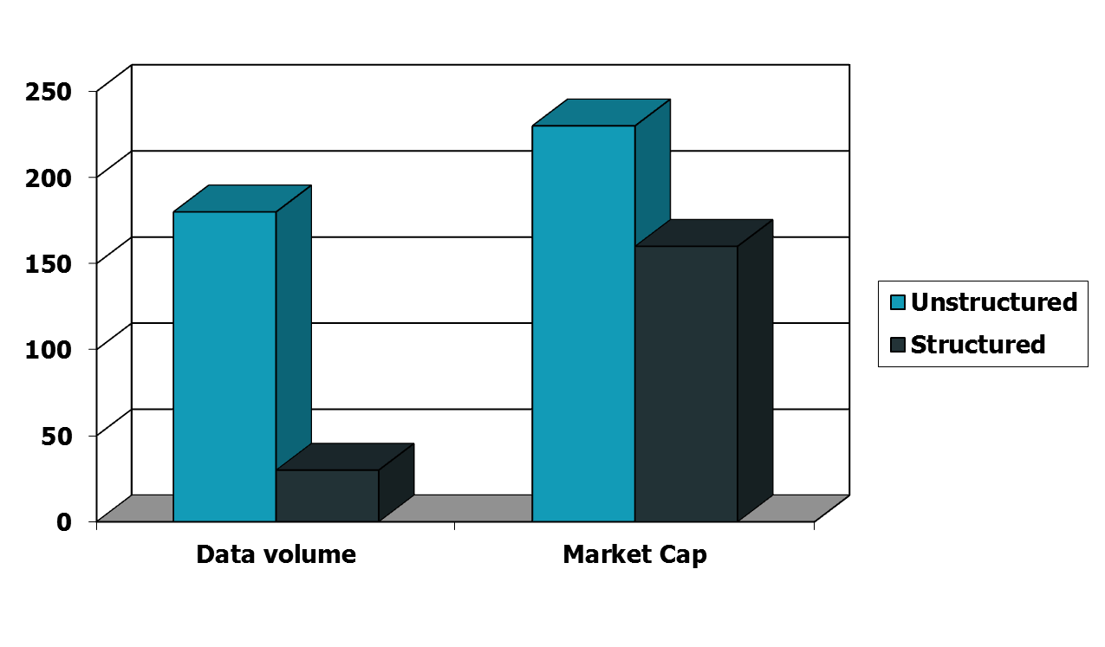
Unstructured (text) vs. structured (database) data today
Notes:
To the surprise of many, the search box has become the preferred method of information access.
Customers ask: Why can’t I search my database in the same way?

Slide 8
Basic assumptions of Information Retrieval
Sec. 1.1
Collection: A set of documents
Assume it is a static collection for the moment
Goal: Retrieve documents with information that is relevant to the user’s information need and helps the user complete a task

Slide 9
The classic search model
User task
Get rid of mice in a politically correct way
Misconception?
Info need
Info about removing mice
without killing them
Misformulation?
Query
how trap mice alive
Search
Search
engine
Query refinement
Results
Collection

Slide 10
How good are the retrieved docs?
Sec. 1.1
Precision : Fraction of retrieved docs that are relevant to the user’s information need
Recall : Fraction of relevant docs in collection that are retrieved
More precise definitions and measurements to follow later

Slide 11
Structured vs. Unstructured Data

Slide 12
IR vs. databases: Structured vs unstructured data
Structured data tends to refer to information in “tables”
Employee
Manager
Salary
Smith
Jones
50000
Chang
Smith
60000
Ivy
Smith
50000
Typically allows numerical range and exact match
(for text) queries, e.g.,
Salary < 60000 AND Manager = Smith.

Slide 13
Unstructured data
Typically refers to free text
Allows
Keyword queries including operators
More sophisticated “concept” queries e.g.,
find all web pages dealing with drug abuse
Classic model for searching text documents

Slide 14
Semi-structured data
In fact almost no data is “unstructured”
E.g., this slide has distinctly identified zones such as the Title and Bullets
… to say nothing of linguistic structure
Facilitates “semi-structured” search such as
Title contains data AND Bullets contain search
Or even
Title is about Object Oriented Programming AND Author something like stro*rup
where * is the wild-card operator

Slide 15
Term-document incidence matrices

Slide 16
Unstructured data in 1620
Sec. 1.1
Which plays of Shakespeare contain the words Brutus AND Caesar but NOT Calpurnia?
One could grep all of Shakespeare’s plays for Brutus and Caesar, then strip out lines containing Calpurnia?
Why is that not the answer?
Slow (for large corpora)
NOT Calpurnia is non-trivial
Other operations (e.g., find the word Romans near countrymen) not feasible
Ranked retrieval (best documents to return)
Later lectures
Notes:
Grep is line-oriented; IR is document oriented.

Slide 17
Term-document incidence matrices
Sec. 1.1
1 if play contains word, 0 otherwise
Brutus AND Caesar BUT NOT Calpurnia

Slide 18
Incidence vectors
Sec. 1.1
So we have a 0/1 vector for each term.
To answer query: take the vectors for Brutus, Caesar and Calpurnia (complemented) ➔ bitwise AND.
110100 AND
110111 AND
101111 =
100100

Slide 19
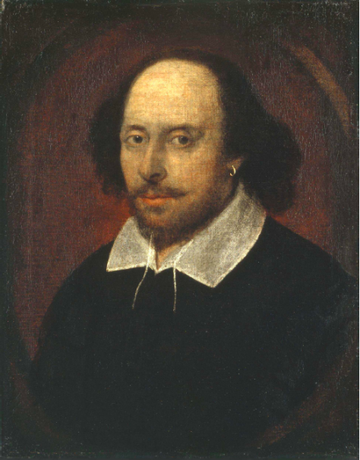
Answers to query
Sec. 1.1
Antony and Cleopatra, Act III, Scene ii
Agrippa [Aside to DOMITIUS ENOBARBUS]: Why, Enobarbus,
When Antony found Julius Caesar dead,
He cried almost to roaring; and he wept
When at Philippi he found Brutus slain.
Hamlet, Act III, Scene ii
Lord Polonius: I did enact Julius Caesar I was killed i’ the
Capitol; Brutus killed me.
Notes:
Wikimedia commons picture of Shake

Slide 20
Bigger collections
Sec. 1.1
Consider N = 1 million documents, each with about 1000 words.
Avg 6 bytes/word including spaces/punctuation
6GB of data in the documents.
Say there are M = 500K distinct terms among these.

Slide 21
Can’t build the matrix
Sec. 1.1
500K x 1M matrix has half-a-trillion 0’s and 1’s.
But it has no more than one billion 1’s.
matrix is extremely sparse.
What’s a better representation?
We only record the 1 positions.
Why?

Slide 22
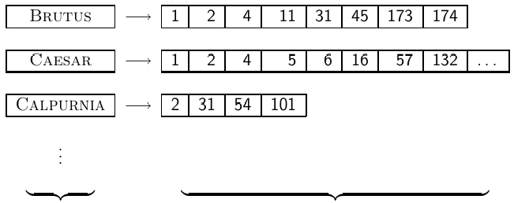
Inverted Index
For each term t, we store a list of all documents that contain t.
dictionary postings
22

Slide 23
Inverted Index
For each term t, we store a list of all documents that contain t.
dictionary postings
23

Slide 24
Inverted Index
For each term t, we store a list of all documents that contain t.
dictionary postings
24

Slide 25



Inverted index construction
Collect the documents to be indexed:
Tokenize the text, turning each document into a list of tokens:
Do linguistic preprocessing, producing a list of normalized tokens, which are the indexing terms:
Index the documents that each term occurs in by creating an
inverted index, consisting of a dictionary and postings.

Slide 26
Initial stages of text processing
Tokenization
Cut character sequence into word tokens
Deal with “John’s”, a state-of-the-art solution
Normalization
Map text and query term to same form
You want U.S.A. and USA to match
Stemming
We may wish different forms of a root to match
authorize, authorization
Stop words
We may omit very common words (or not)
the, a, to, of

Slide 27
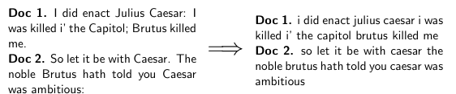
Tokenizing and preprocessing
27

Slide 28
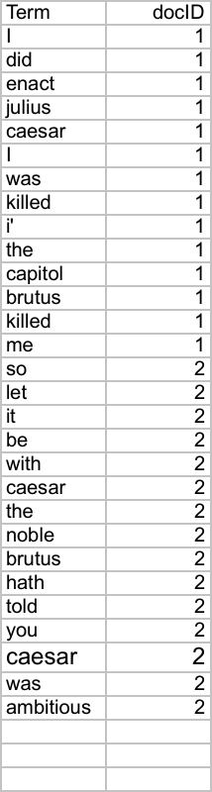
Indexer steps: Token sequence
Sec. 1.2
Sequence of (Modified token, Document ID) pairs.
Doc 1
Doc 2
I did enact Julius
Caesar I was killed
i’ the Capitol;
Brutus killed me.
So let it be with
Caesar. The noble
Brutus hath told you
Caesar was ambitious

Slide 29
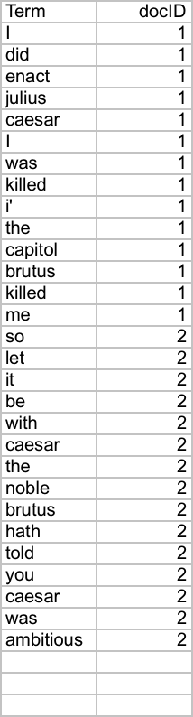
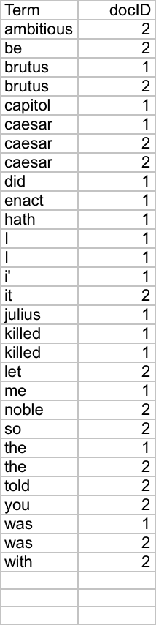
Indexer steps: Sort
Sec. 1.2
Sort by terms
And then docID
Core indexing step

Slide 30
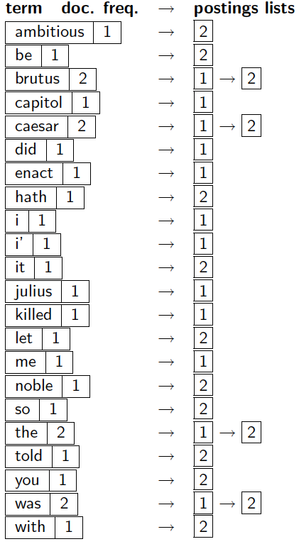
Indexer steps: Dictionary & Postings
Sec. 1.2
Multiple term entries in a single document are merged.
Split into Dictionary and Postings
Doc. frequency information is added.
Why frequency?
Will discuss later.

Slide 31
Query processing with an inverted index

Slide 32
The index we just built
Sec. 1.3
Our focus
How do we process a query?
Later - what kinds of queries can we process?

Slide 33
Query processing: AND
Sec. 1.3
Consider processing the query:
Brutus AND Caesar
Locate Brutus in the Dictionary;
Retrieve its postings.
Locate Caesar in the Dictionary;
Retrieve its postings.
“Merge” the two postings (intersect the document sets):
2
4
8
16
32
64
128
Brutus
1
2
3
5
8
13
21
34
Caesar

Slide 34
The merge
Sec. 1.3
Walk through the two postings simultaneously, in time linear in the total number of postings entries
2
4
8
16
32
64
128
Brutus
1
2
3
5
8
13
21
34
Caesar
If the list lengths are x and y, the merge takes O(x+y)
operations.
Crucial: postings sorted by docID.

Slide 35
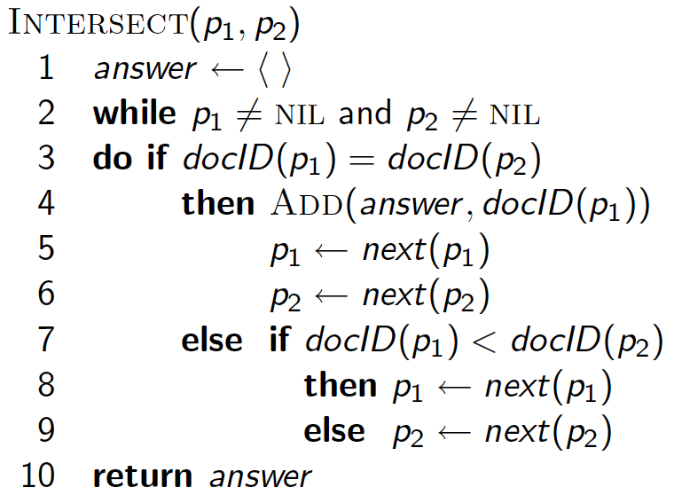
Intersecting two postings lists (a “merge” algorithm)

Slide 36
Boolean queries: Exact match
Sec. 1.3
The Boolean retrieval model is being able to ask a query that is a Boolean expression:
Boolean Queries are queries using AND, OR and NOT to join query terms
Views each document as a set of words
Is precise: document matches condition or not.
Perhaps the simplest model to build an IR system on
Primary commercial retrieval tool for 3 decades.
Many search systems you still use are Boolean:
Email, library catalog, Mac OS X Spotlight

Slide 37
Example: WestLaw http://www.westlaw.com/
Sec. 1.4
Largest commercial (paying subscribers) legal search service (started 1975; ranking added 1992; new federated search added 2010)
Tens of terabytes of data; ~700,000 users
Majority of users still use boolean queries
Example query:
What is the statute of limitations in cases involving the federal tort claims act?
LIMIT! /3 STATUTE ACTION /S FEDERAL /2 TORT /3 CLAIM
/3 = within 3 words, /S = in same sentence

Slide 38
Inverted Index
For each term t, we store a list of all documents that contain t.
dictionary postings
38

Slide 39
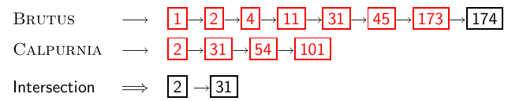
Intersecting two posting lists
39

Slide 40
Take-away
Understanding of the basic unit of classical information retrieval systems: words and documents: What is a document, what is a term?
Tokenization: how to get from raw text to words (or tokens)
40

Slide 41
Documents
Simple Boolean retrieval system
Our assumptions were:
We know what a document is.
We can “machine-read” each document.
This can be complex in reality.
41

Slide 42
Parsing a document
We need to deal with format and language of each document.
What format is it in? pdf, word, excel, html etc.
What language is it in?
What character set is in use?
Each of these is a classification problem, which we will study later in this course (IIR 13).
Alternative: use heuristics
42

Slide 43
Format/Language: Complications
A single index usually contains terms of several languages.
Sometimes a document or its components contain multiple languages/formats.
French email with Spanish pdf attachment
What is the document unit for indexing?
A file?
An email?
An email with 5 attachments?
A group of files (ppt or latex in HTML)?
Upshot: Answering the question “what is a document?” is not trivial and requires some design decisions.
Also: XML
43

Slide 44
Definitions
Word – A delimited string of characters as it appears in the text.
Term – A “normalized” word (case, morphology, spelling etc); an equivalence class of words.
Token – An instance of a word or term occurring in a document.
Type – The same as a term in most cases: an equivalence class of tokens.
44

Slide 45
Normalization
Need to “normalize” terms in indexed text as well as query terms into the same form.
Example: We want to match U.S.A. and USA
We most commonly implicitly define equivalence classes of terms.
Alternatively: do asymmetric expansion
window → window, windows
windows → Windows, windows
Windows (no expansion)
More powerful, but less efficient
Why don’t you want to put window, Window, windows, and Windows in the same equivalence class?
45

Slide 46

Recall: Inverted index construction
Input:
Output:
Each token is a candidate for a postings entry.
What are valid tokens to emit?
46

Slide 47
Tokenization problems: One word or two? (or several)
Hewlett-Packard
State-of-the-art
co-education
the hold-him-back-and-drag-him-away maneuver
data base
San Francisco
Los Angeles-based company
cheap San Francisco-Los Angeles fares
York University vs. New York University
47

Slide 48
Numbers
3/20/91
20/3/91
Mar 20, 1991
B-52
100.2.86.144
(800) 234-2333
800.234.2333
Older IR systems may not index numbers . . .
. . . but generally it’s a useful feature.
48

Slide 49
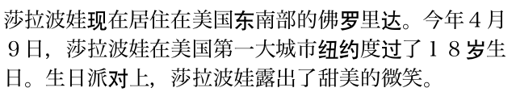
Chinese: No whitespace
49

Slide 50

Ambiguous segmentation in Chinese
The two characters can be treated as one word meaning ‘monk’ or as a sequence of two words meaning ‘and’ and ‘still’.
50

Slide 51
Other cases of “no whitespace”
Compounds in Dutch, German, Swedish
Computerlinguistik → Computer + Linguistik
Lebensversicherungsgesellschaftsangestellter
→ leben + versicherung + gesellschaft + angestellter
Inuit: tusaatsiarunnanngittualuujunga (I can’t hear very well.)
Many other languages with segmentation difficulties: Finnish, Urdu, . . .
51

Slide 52
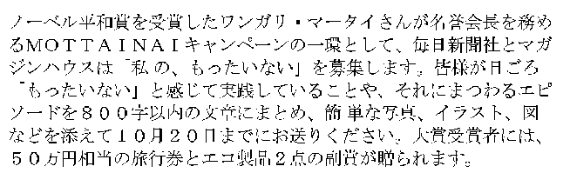
Japanese
4 different “alphabets”: Chinese characters, hiragana syllabary for inflectional endings and functional words, katakana syllabary for transcription of foreign words and other uses, and latin. No spaces (as in Chinese). End user can express query entirely in hiragana!
52

Slide 53
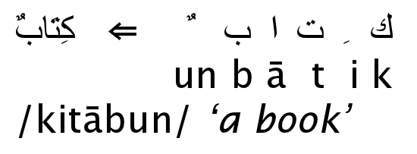
Arabic script
53

Slide 54
Arabic script: Bidirectionality
← → ← → ← START
‘Algeria achieved its independence in 1962 after 132 years of French occupation.’
Bidirectionality is not a problem if text is coded in Unicode.
54

Slide 55
Accents and diacritics
Accents: résumé vs. resume (simple omission of accent)
Umlauts: Universität vs. Universitaet (substitution with special letter sequence “ae”)
Most important criterion: How are users likely to write their queries for these words?
Even in languages that standardly have accents, users often do not type them. (Polish?)
55

Slide 56
Case folding
Reduce all letters to lower case
Possible exceptions: capitalized words in mid-sentence
MIT vs. mit
Fed vs. fed
It’s often best to lowercase everything since users will use lowercase regardless of correct capitalization.
56

Slide 57
Stop words
stop words = extremely common words which would appear to be of little value in helping select documents matching a user need
Examples: a, an, and, are, as, at, be, by, for, from, has, he, in, is, it, its, of, on, that, the, to, was, were, will, with
Stop word elimination used to be standard in older IR systems.
But you need stop words for phrase queries, e.g. “King of Denmark”
Most web search engines index stop words.
57

Slide 58
Lemmatization
Reduce inflectional/variant forms to base form
Example: am, are, is → be
Example: car, cars, car’s, cars’ → car
Example: the boy’s cars are different colors → the boy car be different color
Lemmatization implies doing “proper” reduction to dictionary headword form (the lemma).
Inflectional morphology (cutting → cut) vs. derivational morphology (destruction → destroy)
58

Slide 59
Stemming
Definition of stemming: Crude heuristic process that chops off the ends of words in the hope of achieving what “principled” lemmatization attempts to do with a lot of linguistic knowledge.
Language dependent
Often inflectional and derivational
Example for derivational: automate, automatic, automation all reduce to automat
59

Slide 60
Porter algorithm
Most common algorithm for stemming English
Results suggest that it is at least as good as other stemming options
Conventions + 5 phases of reductions
Phases are applied sequentially
Each phase consists of a set of commands.
60

Slide 61
Porter stemmer: A few rules
Rule
SSES → SS
IES → I
SS → SS
S →
Example
caresses → caress
ponies → poni
caress → caress
cats → cat
61

Slide 62
Exercise: What does Google do?
Stop words
Normalization
Tokenization
Lowercasing
Stemming
Non-latin alphabets
Umlauts
Compounds
Numbers
62

Slide 63
Phrase queries
We want to answer a query such as [stanford university] – as a phrase.
Thus The inventor Stanford Ovshinsky never went to university should not be a match.
The concept of phrase query has proven easily understood by users.
About 10% of web queries are phrase queries.
Consequence for inverted index: it no longer suffices to store docIDs in postings lists.
Two ways of extending the inverted index:
biword index
positional index
63

Slide 64
Biword indexes
Index every consecutive pair of terms in the text as a phrase.
For example, Friends, Romans, Countrymen would generate two biwords: “friends romans” and “romans countrymen”
Each of these biwords is now a vocabulary term.
Two-word phrases can now easily be answered.
64

Slide 65
Longer phrase queries
A long phrase like “stanford university palo alto” can be represented as the Boolean query “STANFORD UNIVERSITY” AND “UNIVERSITY PALO” AND “PALO ALTO”
We need to do post-filtering of hits to identify subset that actually contains the 4-word phrase.
65

Slide 66
Issues with biword indexes
Why are biword indexes rarely used?
False positives, as noted above
Index blowup due to very large term vocabulary
66

Slide 67
Positional indexes
Positional indexes are a more efficient alternative to biword indexes.
Postings lists in a nonpositional index: each posting is just a docID
Postings lists in a positional index: each posting is a docID and a list of positions
67

Slide 68
Positional indexes: Example
Query: “to₁ be₂ or₃ not₄ to₅ be₆” TO, 993427:
‹ 1: ‹7, 18, 33, 72, 86, 231›;
2: ‹1, 17, 74, 222, 255›;
4: ‹8, 16, 190, 429, 433›;
5: ‹363, 367›;
7: ‹13, 23, 191›; . . . ›
BE, 178239:
‹ 1: ‹17, 25›;
4: ‹17, 191, 291, 430, 434›;
5: ‹14, 19, 101›; . . . › Document 4 is a match!
68

